Slide 1
Gopal Sevaks
Team Members :
1. Bablu singh
2. chandra prakash
3. Inesh kumar
4. kartik arora

Slide 2
Our Motive
We are determined to create a full fledged location tracking system
To keep record of personal Children or Animals.
To secure our Children or Animals.
For our first phase of implementation we are only considering Rajasthan as our working state.

Slide 3
Present situation
The irony of the present situation is that despite being a technological modern society using GPS technology and various other data science technology in our day to day life, no authority has ever created such a system dedicated to prevention of children or animals trafficking so far
So, we have no competitor in present context, and we are creating for service to humanity and holy cow, by creating our own standards for this system.

Slide 4
Users
Admin
Owner
Tracker
Children or Animals Tracker, you can follow the movements of Children or Animals all over the our area that are being tracked in near-real time.

Slide 5
These movements are collected by tiny GPS tags carried by the Children or Animals.
Filter Children or Animals species and search for specific individuals. and are able to send accurate, high-resolution information about their movements.

Slide 6
Technology Used
Javascript for the back-end with PHP
Database: MySql
Google Map APIs implemented using Javascript, and other useful Google APIs, with JSON
APIS related to GPS technologies such as gpstrackfit, movingongps are considered for use

Slide 7
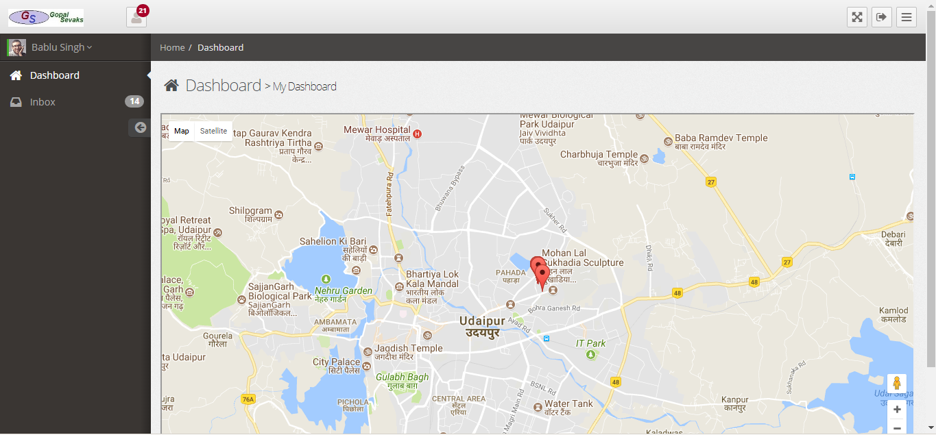
Dashbord

Slide 8
On Dashbord we will show location of Children or Animals with there ID.
On the left side we have navigation panel .
Not only do data dashbord look cool, they keep everyone in the company on the same page.
A data dashbord publicly display all of your important data in real time.

Slide 9
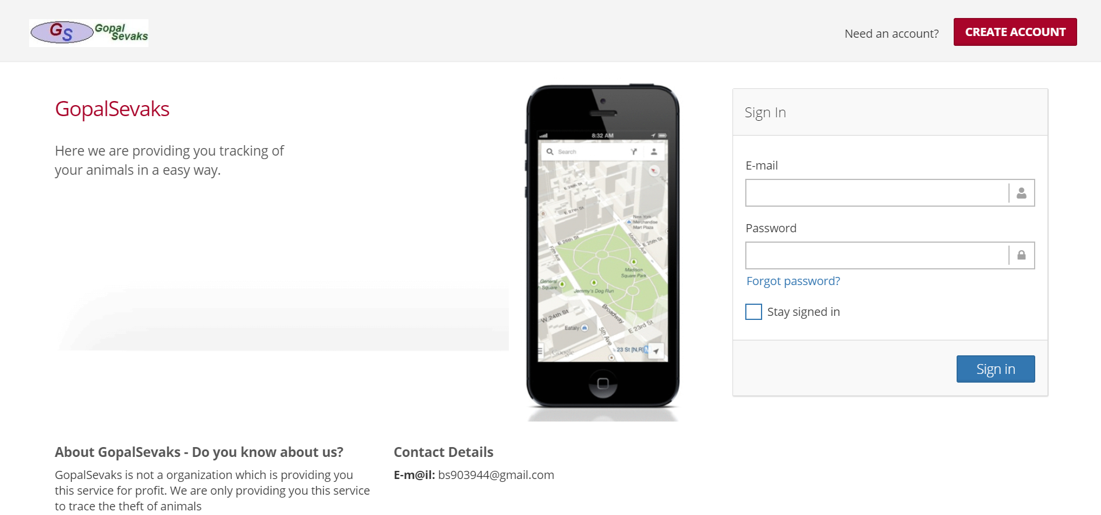
Log in

Slide 10
This is Login page.
Allow a user to reset their password via an email-based forgot password.

Slide 11
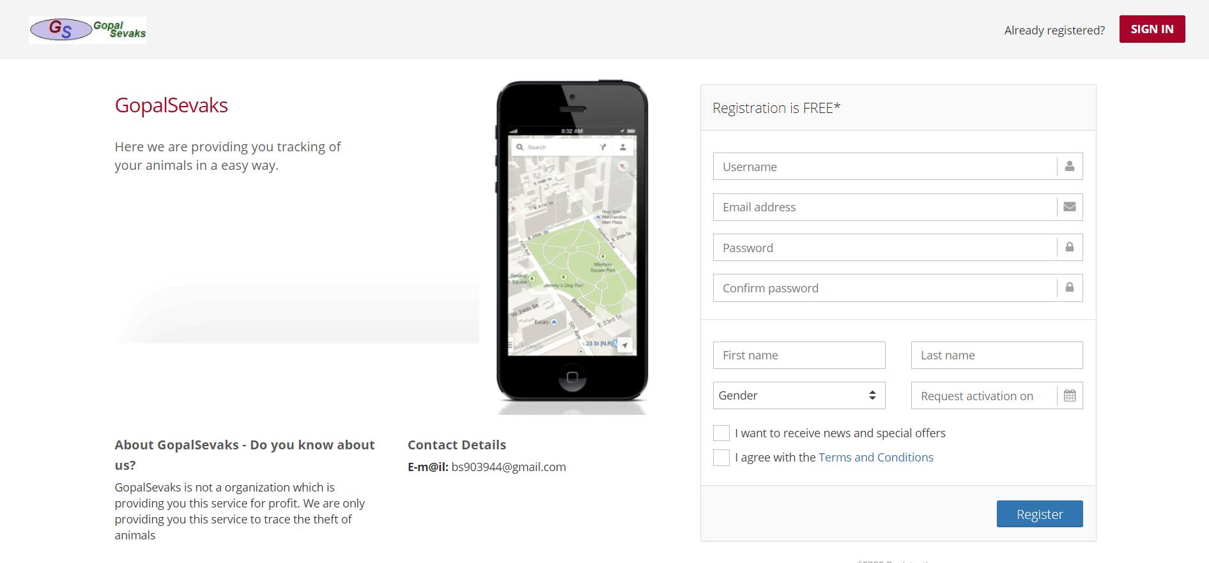
Registration

Slide 12
This is the Registration page to create a new user account with email and password.
Validate the new user account’s registered email address.

Slide 13
THANK YOU

